Slide 1
Future Funding Opportunities Pippa Langford
Notes:
Introduce myself,
Work for Natural England and Countryside Agency (8 years)
Led on ...previously worked on RDPE, Coastal access, national trails, open access, ANGSt
Director for Wildlife and Countryside Link during last CAP negotiations – represented Links’ view to Ministers, MPs, civil servants (2 years)
Senior Lecturer in Rural Policy – with particular specialism on CAP and countryside recreation and access (approximately 11 years)

Slide 2
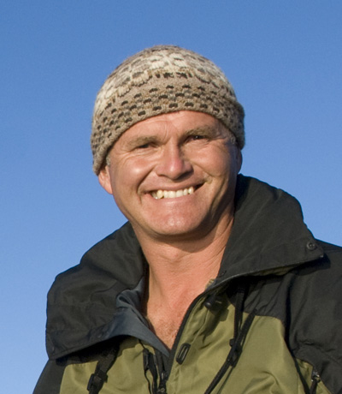
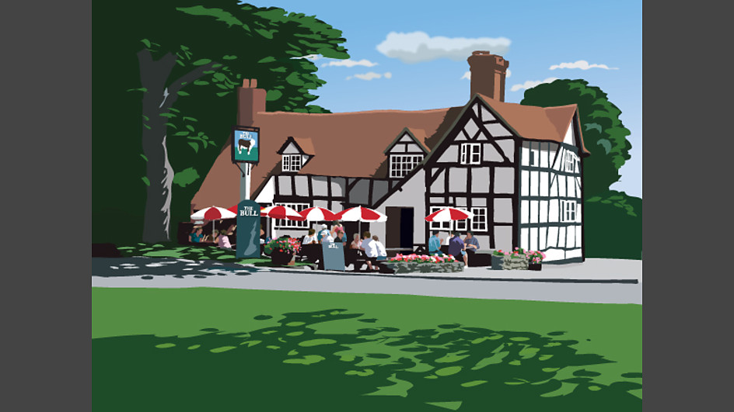
Quiz: Who or what are they?

Slide 3
Money
Who will be deciding how EU funds are spent in the future?
What are their common interests?
Where is the money?
What next? Tools to help....

Slide 4
What’s in it for me?
Notes:
The Bull – Ambridge
LEPs - 39 – some overlap
LEPs are partnerships between local government and local authorities, The Govt has written to the Chairs of the LEPs outlining the next steps in the evolution of the nationally allocated EU programmes 2014-20 ("the Structural Funds"). This INCLUDES a recommendation to connect with LNPs re: the design and delivery of prioriites

Slide 5
Engaging with the natural environment is good for growth
Spend - £20 billion
Those with children spend more
Urban dwellers spend more than country dwellers
Foreign tourists
Horse riders
Cyclists
Notes:
£40 million per constituency
£225 million per county/unitary/metropolitan borough
MENE 2011/12
What is in it for LEPs?
the significance of engaging and involving young people in experiences of the natural environment – visits involving children are twice as likely to involve expenditure and currently make up around 35% of the visits which contribute £6.7bn to the economy annually
Monitor of Engagement with the Natural Environment (MENE) - 2.49 billion visits to natural environment during 2010/11
- visitors spending just over £20 billion
National Trails - South West Coast Path
- £300 million a year for region, supporting over 7,500 jobs
National Equestrian Survey (2005-6)
- 4.3 million had ridden in the past 12 months, 7,500 jobs
GB Tourism Survey 2011
- trips to the countryside, totalling 60.41 million nights and a spend of £2.9 billion
International Passenger Survey ONS
- £1.87 billion overseas expenditure from people enjoying the countryside and coast

Slide 6
Case study - Return on Investment
Wensum Way £40K investment
Worth £100K pa to local businesses
“We are in a recession so trading in Mid Norfolk is very difficult, but there are definitely business opportunities here if you have got the facilities and you get the footfall”
Notes:
The Wensum Way itself will stretch from the Gressenhall Farm and Workhouse museum to Lenwade, and will include a link to the market town of Dereham.
Norfolk County Council is spending about £40,000 to upgrade the route’s surfacing, gates and signposting to the required standards – and estimates that the investment will be repaid with increased customer footfall worth £100,000 a year to local businesses.

Slide 7
What’s in it for me?
Notes:
Simon King President of The Wildlife Trusts
48 in England
LEPS have been told to talk to LNPs – so LNPs will influence (in some places) the shape of economic growth, and the allocation of funds.
LNPs are expected to promote cooperation between local authorities, Local Economic Partnerships, and Health and Wellbeing Boards.
LNPs have been empowered to identify further locally-determined Nature Improvement Areas against defined criteria, and local authorities have a Duty to Cooperate with LNPs on statutory plans under the Localism Act.
Progress of developing LNPs has been variable. The Wild Anglia LNP has developed close links with the Local Enterprise Partnership, resulting in the LEP’s Pathfinder for the Green Economy placing a strong emphasis on the value of the natural environment
The more successful LNPs tend to exhibit some or all of the following characteristics: the level of energy and enthusiasm present at establishment, leadership to galvanise a vision, the availability of management/administration to support the partnership, and the existence of issues or causes around which the partnership can coalesce
LNPs have a potential role in deciding local priorities for EU funding. LEPs are being considered among options for distributing future EU structural funds, and strongly-established LNPs with good working relationships with their LEPs could ensure that environmental benefits were fully integrated into potential projects
A shared view of local environmental priorities supported by local communities has the potential to turn the theory of ecosystem services at a landscape scale into real delivery on the ground.
The duty under the Localism Act for planning authorities to cooperate with LNPs offers considerable opportunity to guide and influence local strategic planning.
Future targeting of agri-environment schemes could be steered or coordinated at a local level through LNPs.
Successful LNPs offer NE a ready-made mechanism for engaging across the full range of social, environmental and economic outcomes at a local level

Slide 8
Visiting the natural environment means people care more
The more frequent people visit the natural environment, the more likely they are to appreciate it and be concerned about environmental damage
Frequent visitors are more likely to engage in pro-environmental behaviours
But
Children now spend less time playing in natural places than they did in previous generations
Notes:
MENE findings indicate that the more frequently people visit the natural environment, the more likely they are to appreciate it and to be concerned about environmental damage. Frequent visitors are also more likely to engage in pro-environmental behaviours such as recycling and preferring to buy seasonal and locally grown food.
But
Research commissioned by Natural England highlights the differences in patterns of outdoor play between different generations. It suggests that children now spend less time playing in natural places than they did in previous generations (England Marketing 2009).
Do we have a crisis? And an opportunity?

Slide 9
What’s in it for me?
Notes:
Dr George Clooney
150 HWBB
Their core role is to set a joint health and wellbeing strategy (JHWS) for each upper tier council area (for example county and city councils and London boroughs).

Slide 10
Good quality access to the natural environment is good for people’s health
If every household were provided with good access to quality greenspace, an estimated £2.1 billion in health care costs would be saved. Poor natural environment leads to health inequalities
(NEWP paragraph 4.5).
Notes:
The evidence points to a disconnect between people and nature and less outdoor activity and reduced contact with nature have negative consequences for public health.
And don’t forget – local authorities now have public health duties – but no cash for prevention. If they can begin to see that spending EU funds can bring economic growth and help them to improve public health then they are likely to take the opportunity

Slide 11
Barriers and solutions
Fragmented network
Lack of confidence – not clear were to go and what is allowed
Don’t know where to go or what to do
Lack of facilities (tea and toilets)
Measures to permanently join up and upgrade the paths and spaces network for all users
Better offer – improved surfaces, better signage (how far and where to), better gates, better entrances
Better promotion of facilities, trails and networks
Support for businesses, customer service training, start-ups, mentoring.

Slide 12
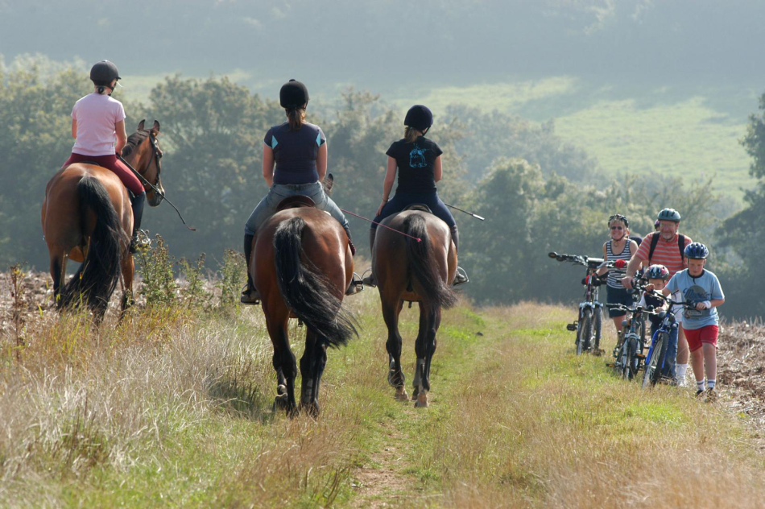
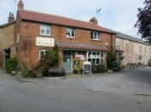
What funding could be available to increase footfall, hoofall, and pedal push?

Slide 13
EU COMMON STRATEGIC FRAMEWORK FUNDS IN ENGLAND 2014-2020 Cross cutting themes
Sustainable Development – Environmental protection requirements, resource efficiency, climate change mitigation and adaptation, disaster resilience, risk prevention and management.
Equality between men and women and, non discrimination.

Slide 14
Relevant themes in EAFRD
Strengthening research, technological development and innovation
Enhancing the competitiveness of small and medium-sized enterprises, the agricultural sector
Protecting the environment and promoting resource efficiency
Promoting social inclusion and combating poverty
Investing in education, skills and lifelong learning

Slide 15
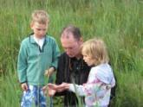
Relevant themes in ERDF
Enhancing access to, and use and quality of, information and communication technologies
Protecting the environment and promoting resource efficiency
Promoting sustainable transport
Promoting social inclusion and combating poverty

Slide 16
EAFRD paragraph 24 states:
“The development of local infrastructure and local basic service in rural areas including leisure and culture, the renewal of villages and activities aimed at the restoration and upgrading of the cultural and natural heritage of villages and rural landscapes is an essential element of any effort to realise the growth potential and promote the sustainability of rural areas. Support should therefore be granted to operations with this aim.”
Notes:
Note: EU EAFRD funds do not have to be given to farmers/landowners. The draft regulation is very clear on this. Funds can be given to others.
Funds can be spent on PROW, just not on statutory duties: funds can be used to install new bridleway gates, improve the surface. It can also be given to do promotion

Slide 17
Environmental Stewardship Permissive Access - Challenges
Value for money?
Not demand-led and responsive to access needs
Created few links to open access land and National Trails
Standard of routes created varied widely
Lack of information/promotion
Lack of monitoring to evaluate the range of benefits to community and the economy

Slide 18
Paths for Communities - positives
Community-led
Strong involvement of local land owners, businesses, variety of community users (schools/youth groups, equestrians, cyclists, societies, GPs)
Partnership with local authorities (esp PROW team, LAFs)
Benefits to rural businesses
Permanent access created

Slide 19
Paths for Communities - challenges
Restricted to rural areas – or where a route connects to rural business/community
Retrospective payment of grant
Time to negotiate with a range of partners and stakeholders
Scale of benefits – may be small

Slide 20
Why should public funds be used to improve access to the natural environment?
It’s popular
Public access and engagement with the natural environment is a public good. The economic benefits from public access are considerable, benefits accrue to:
private businesses,
individuals and
the state

Slide 21
Some final ideas....other sources of funding
Visitor payback schemes
Crowd funding
Notes:
Barriers to VPB schemes are: high set up costs – particulary IT
But what do visitors want their money to be spent on – 2 main things – paying for paths and planting trees
Could EU funds be used to set up visitor payback schemes – could one national co-ordinator put toegether the software to support many local schemes?
Crowd funding for particular projects or parts of projects? Spacehive

Slide 22
Next steps
Consultation on EAFRD coming soon
Providing evidence and advice to LNPs, LEPs and HWBB

